Slide 1
5 Reasons to Attend Consult-Con
Theme - Recharging, Rebalancing and Resetting in Post Covid World.

Slide 2
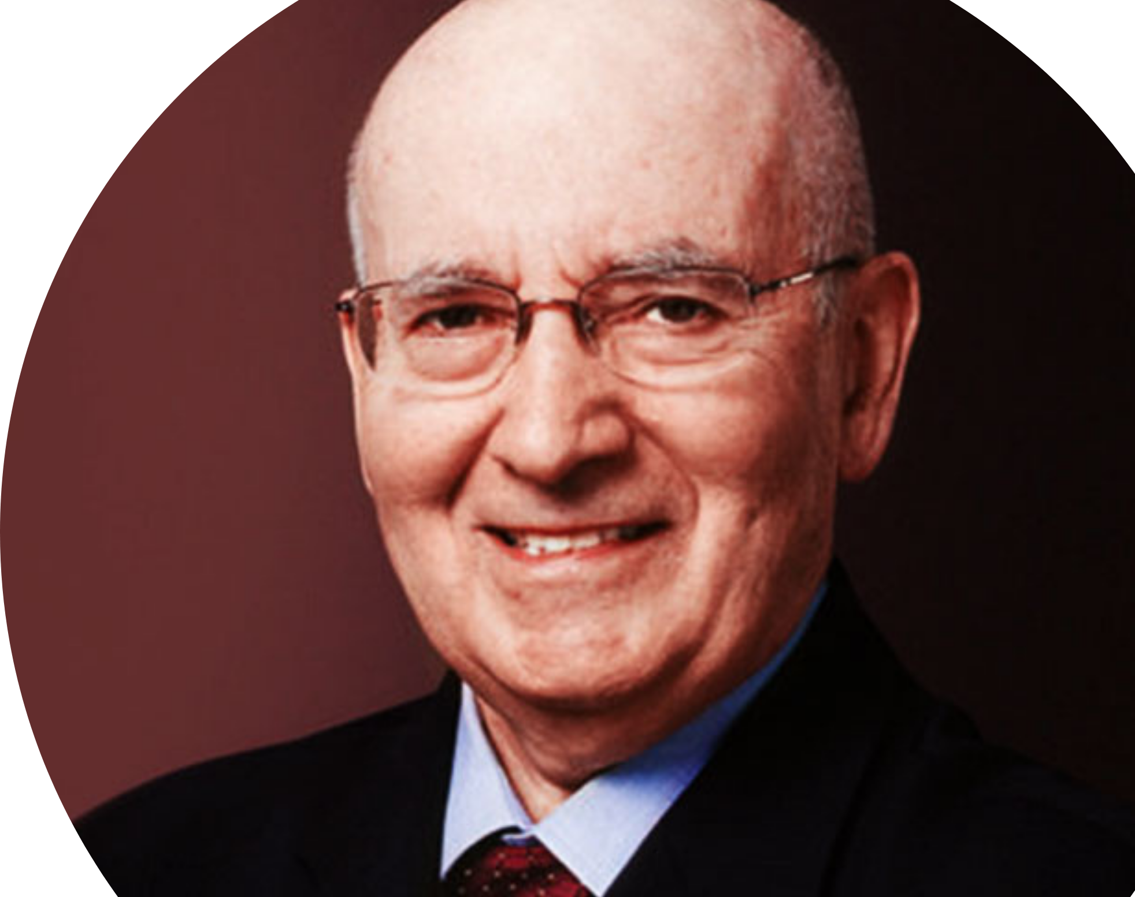
[Learn From Two of The Most Influential Business Thinkers of Our Lifetime] #1 – Dr. Philip Kotler
Reason #1: Continuous Development
Considered by many as the father of modern marketing
Created Marketing as a Field of Study.
Wrote 80 Books on Marketing.
Defined the Terms: Target Marketing; Marketing Management.; Customer Focus; Marketing Mix; Brand Marketing & Positioning; Marketing Analysis
KEYNOTE: Talking About the Future of Marketing (or Marketing 3.0.)
Philip Kotler

Slide 3
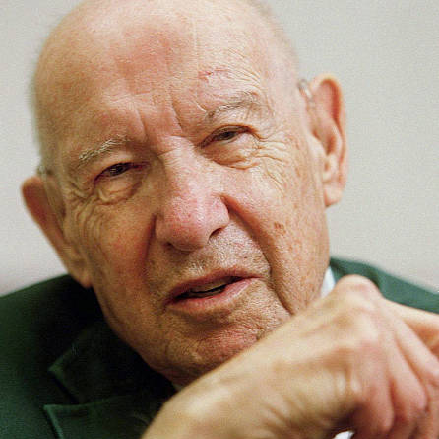
[Learn From Two of The Most Influential Business Thinkers of Our Lifetime]
Reason #1: Continuous Development
Peter F. Drucker
Considered the “Father of Modern Management.”
Attended a class taught by Economist John Maynard Keynes. Told Keynes he talked too much about markets and not enough about people.
Wrote 60 books including “Concept of the Corporation” and “The Future of Industrial Man.”
As a Consultant, suggested General Motors rethink many of its Policies and Practices.
Often wrote on the topics of How Companies Can Get The Most Out of Workers and How Workers Can Find Dignity & Community Through Work.
Performed half his work “Pro Bono” For Non-Profits and Small Businesses.
Created one of the first Executive MBA Programs at Claremont College.

Slide 4
Reason #2: Improving Your Business
Panel Discussions:
Consulting In A Post-Covid World
International Consulting Opportunities
Topics Will Include Strategy, Innovation, Digital, Data And More.
Keynote: Dr. Erin Kelly, MIT Professor of Work and Organization Studies Expert on Work Redesign & Wellbeing, The Future of Work, and Organizational Practices.
Breakout Sessions: Focused on Industry Niches And Topics.

Slide 5
Reason #3: Networking Get Advice – Gain A Different Perspective – Develop Long-Term Relationships – Strengthen Business Connections – Get New Tips & Ideas – Elevate Your Profile – Advance Your Career – Gain More Knowledge – Meet New People – Be Inspired – Remain Relevant – Catch Up With Old Friends – Find Out What’s Working.

Slide 6
Reason #4: Strengthen Your Brand

Slide 7
Sponsorship Options
Diamond Sponsorship - $1,000
2 Conference Tickets
Two (2) e-mails to all Attendees & Speakers
Recognition on Conference Website
10 Minute Speaking Opportunity
Platinum Sponsorship $500
Conference Ticket
One e-mail to all Attendees & Speakers
Recognition on Conference Website
Opportunity to Introduce a Speaker
Gold Sponsorship $250 – Best Option if you can’t attend the Conference and want to Promote Your Business on the Conference Web Site

Slide 8
Reason #5: To Have Fun!
Virtual Yoga
Wine Tasting / Social Hours

Slide 9
Spread the Word!
Conference / Membership Combo Pricing*
Conference Ticket PLUS Membership through Dec 2022
Professional Member: $525
Young Professional Member: $299
Student: $95
Affiliate: $744
International Members: $279
*This Offer Expires on October 31, 2021 !

